Slide 1


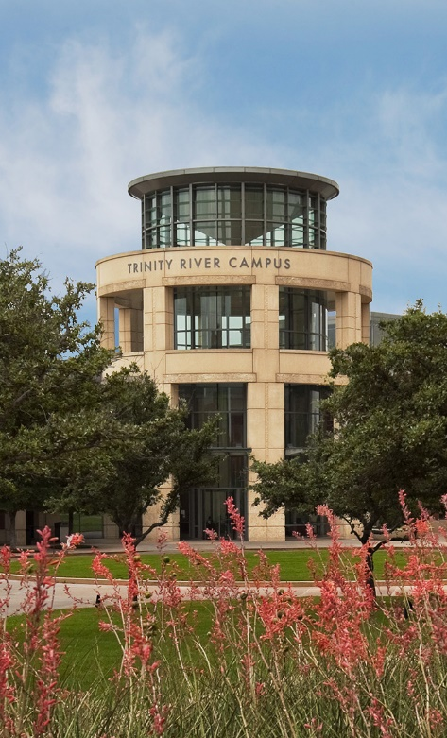
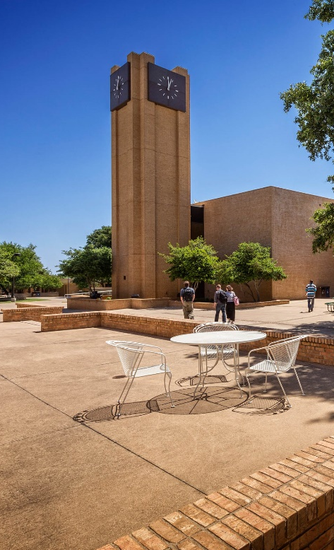
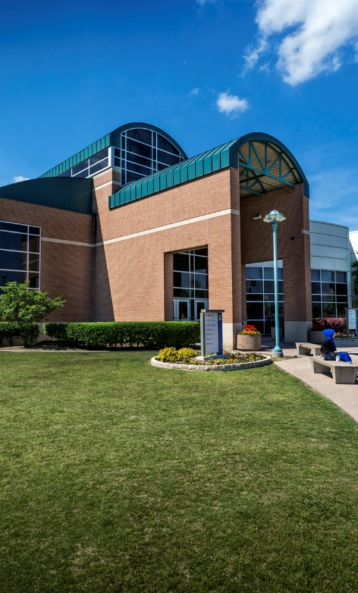

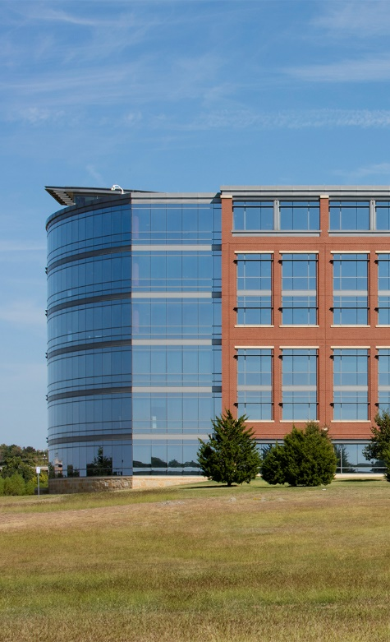
Do You Git It Now? Version Control & Collaboration with Git & GitHub
OFFICE OF INSTITUTIONAL RESEARCH
August 2020
Office of Institutional Research

Slide 2
Do You Git It Now? Version Control & Collaboration with Git & GitHub
OFFICE OF INSTITUTIONAL RESEARCH
August 2020
Office of Institutional Research

Slide 3
What is Version Control?
Version Control Systems (VCS) help manage changes to files
Database of all changes: who, what, when, and why
Undo changes even after saving and closing
Help you collaborate
Don’t have to wait for a green light
Work on the same file at the same time
No emailing files back and forth
Office of Institutional Research

Slide 4
What is Version Control? Why should I use it?
Version Control Systems (VCS) help manage changes to files
Database of all changes: who, what, when, and why
Undo changes even after saving and closing
Help you collaborate
Don’t have to wait for a green light
Work on the same file at the same time
No emailing files back and forth
Office of Institutional Research

Slide 5
What is Version Control? Why should I use it?
Office of Institutional Research

Slide 6
Title
Text
Office of Institutional Research

Slide 7
Title
Text
Office of Institutional Research

Slide 8
Title
Text
Office of Institutional Research

Slide 9
Title
Text
Office of Institutional Research

Slide 10
Title
Text
Office of Institutional Research

Slide 11
Title
Text
Office of Institutional Research

Slide 12
Title
Text
Office of Institutional Research

